Slide 1

introduction to deep learning
Dr. Karen Mazidi

Slide 2
Utilizing the TF Functional API
Custom models
Custom layers
Custom loss functions
Where we are:
Part 1 – ML Foundations
Part 2 – Deep Learning with Keras
Part 3 – Advanced Techniques
Part 4 – Presentations and Evaluations

Slide 3
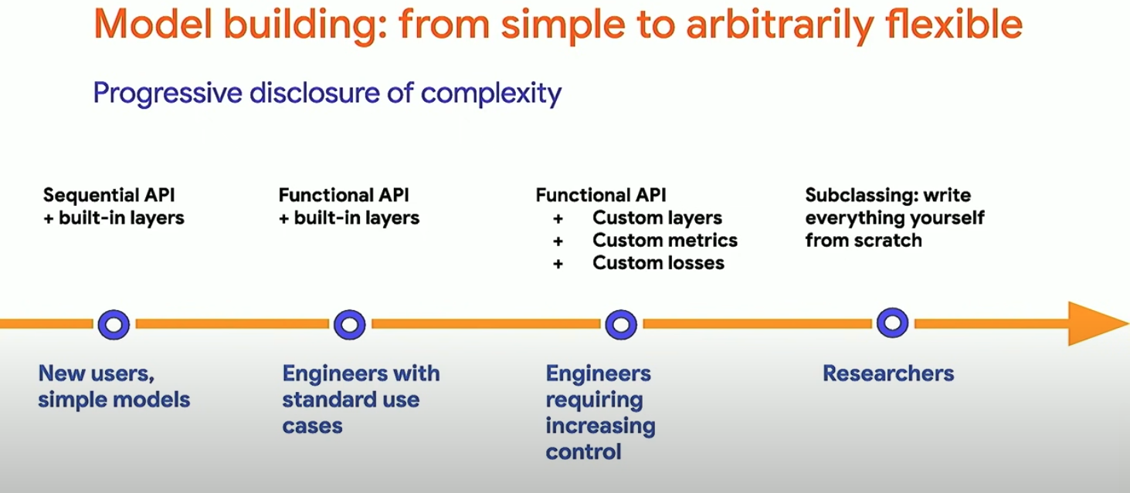
80-90% of models work just fine in Sequential API

Slide 4

Notebooks
1a-Multi-output task
1b-Siamese network
1c-Lambda layer
1d-Custom layer with activation
1e-Custom model
1f-Resnet
1g-Callbacks
1h-Custom callbacks

Slide 5
Functional API
Documentation: https://www.tensorflow.org/guide/keras/functional
Features:
more flexible than the Keras API
main idea: the model is a directed acyclic graph (DAG) of layers
Things you can do with the functional API:
create custom layers
have multiple inputs or outputs
create custom training loops

Slide 6
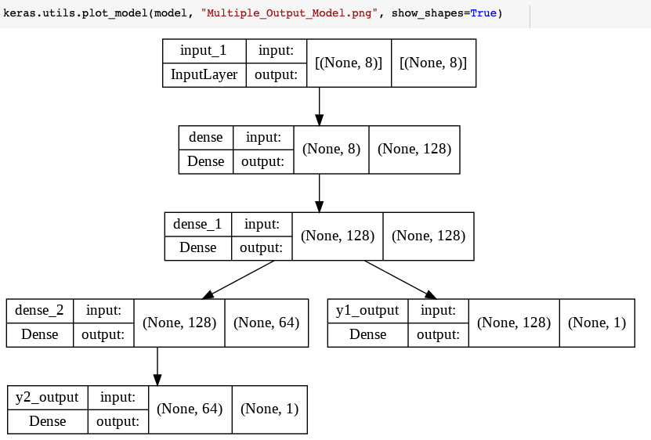
Multi-output model (Notebook 1a)
input data: features of different building shapes
output: y1 is the heating load, y2 is the cooling load

Slide 7
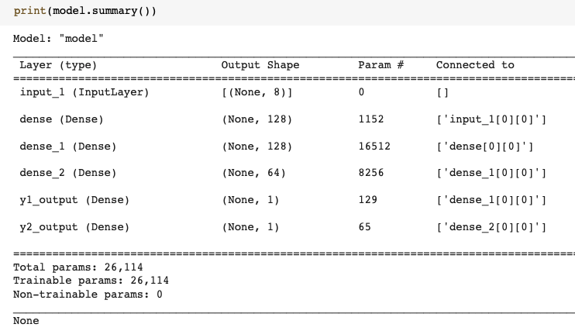
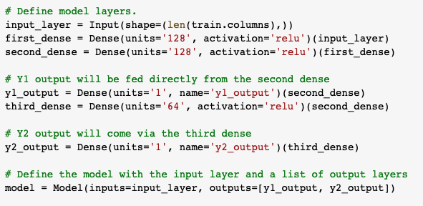
Multi-output model (Notebook 1a)

Slide 8
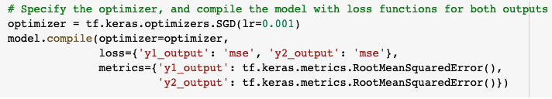
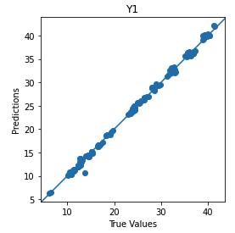
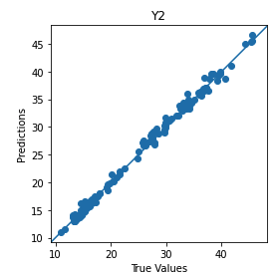
Multi-output model (Notebook 1a)
optimizer, loss and metrics can differ for each output
train for 500 epochs
y1 mse = .47
y2 mse = .69

Slide 9
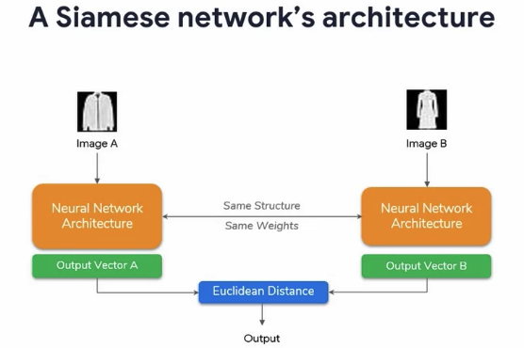
Siamese network (1b)
A Siamese neural network is an artificial neural network that uses the same weights while working in tandem on two different input vectors to compute comparable output vectors
task: find similar articles of clothing from Fashion MNIST

Slide 10
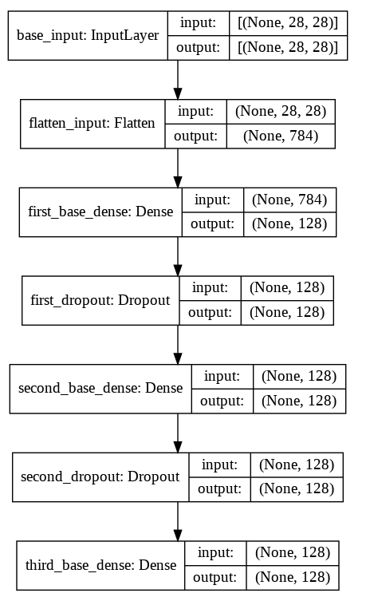
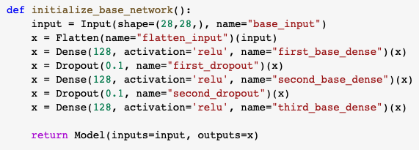
model (notebook 1b)
Base network

Slide 11
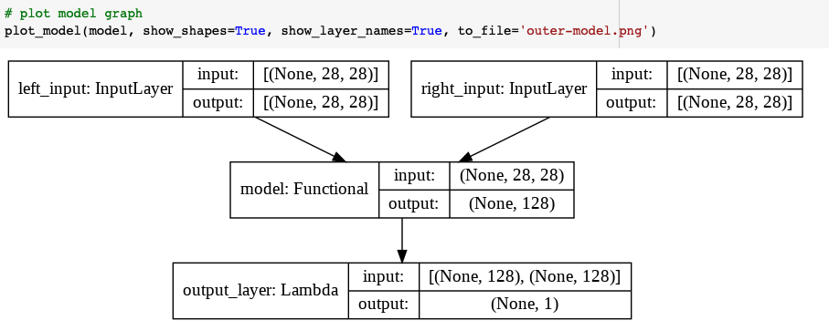
(1b) outer model with data shapes

Slide 12
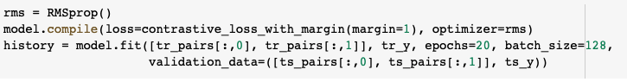
(1b) train and evaluate
train for 20 epochs using a custom loss function
train accuracy = 94%
test accuracy = 91%

Slide 13

Custom Loss Functions
Huber loss example
Binary cross-entropy example
Contrastive loss example

Slide 14
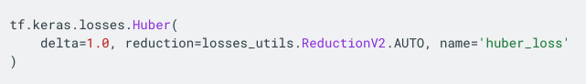
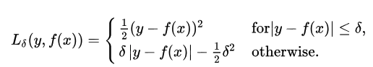
Huber loss
combines MSE and absolute value in a way that the function is differentiable
the loss is quadratic when the error is small; otherwise it is linear and positive
Huber loss is less sensitive to outliers than MSE
the delta parameter can be determined experimentally, a rule of thumb is that is should be less than the residual for the points that are not outliers

Slide 15
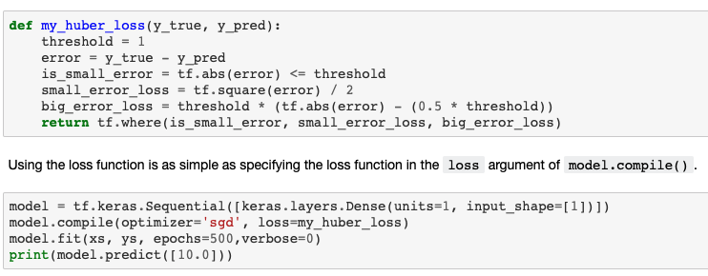
Custom Huber loss

Slide 16
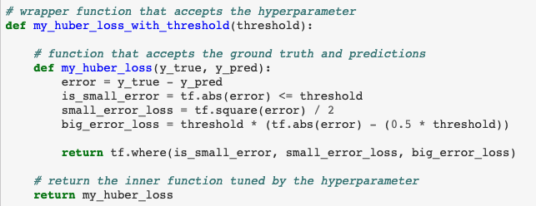
Custom loss with hyperparameter
the loss argument in model.compile( ) only accepts functions with parameters y and y_pred
Workaround: use a wrapper function

Slide 17
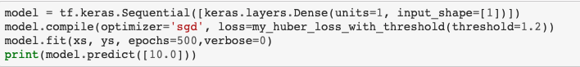
Custom loss with hyperparameter
pass the wrapper function to compile ( )

Slide 18
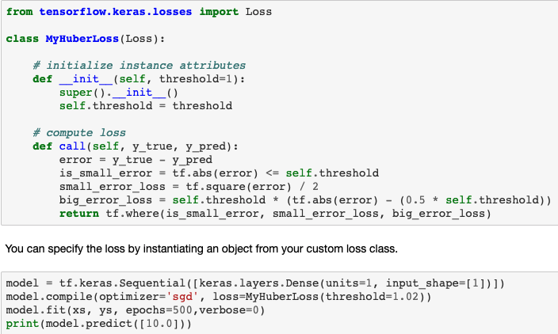
Custom loss as a class

Slide 19
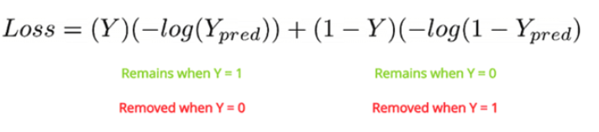
Binary cross-entropy loss
well-suited for binary classification

Slide 20
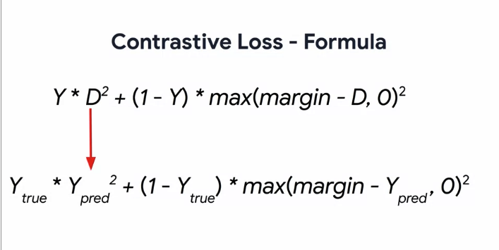
Contrastive loss
measures how well the Siamese network distinguished between image pairs
Y=1 if output pairs are of the same class; 0 otherwise
D is the Euclidean distance between the output pairs
margin is a hyperparameter that helps focus on positive cases and ignore negative cases
Notes:
https://gombru.github.io/2019/04/03/ranking_loss/

Slide 21
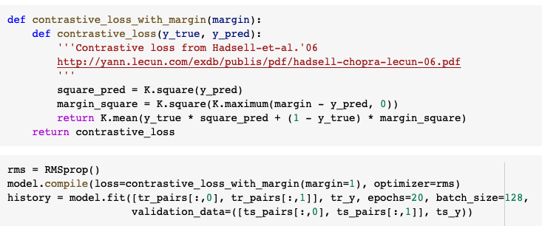
Loss in (1b)

Slide 22
Custom Layers
using a lambda layer with an expression
using a lambda layer with a function
custom layer with activation

Slide 23
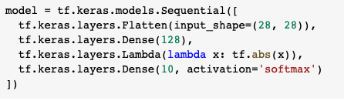
Lambda layer with an expression (1c)
allows expressions to be implemented as layers in a network
caution: models with lambda layers are not as portable as regular layers
below, use a lambda layer to take the absolute value of the layer input

Slide 24
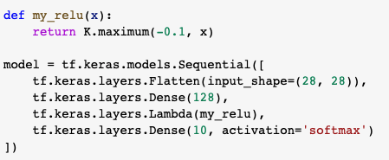
Lambda layer with a function (1c)
another way: pass in a function defined outside the model

Slide 25
(1d) Custom layers with activation
create a custom layer class (next slide)
specify an activation parameter in the __init__ method, and initialize the activation
activation will be one of Keras’ activations: https://keras.io/api/layers/activations/#available-activations
pass in the activation using the call method

Slide 26
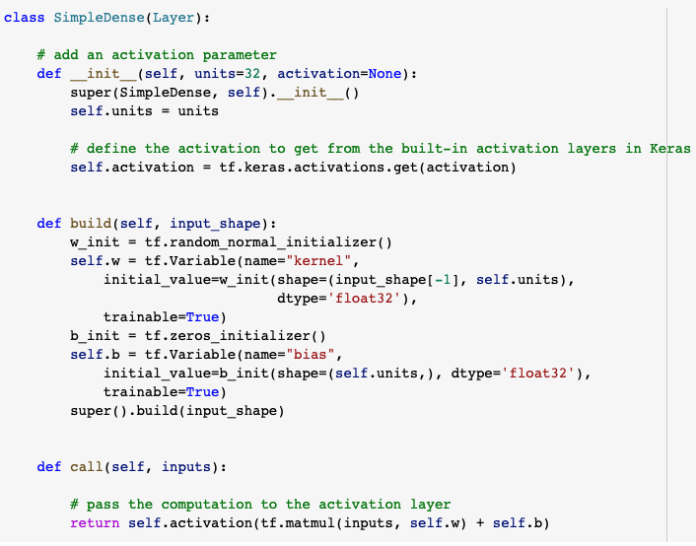
Custom layer (1d)
Note:
activation in __init__
activation in call

Slide 27
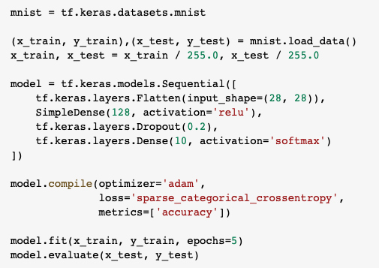
Activation
pass activation to custom layer
‘relu’ gets tf.keras.activation.relu

Slide 28
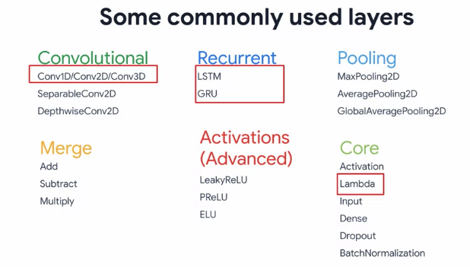

Slide 29
Custom Models
wide and deep model
implement as a class

Slide 30
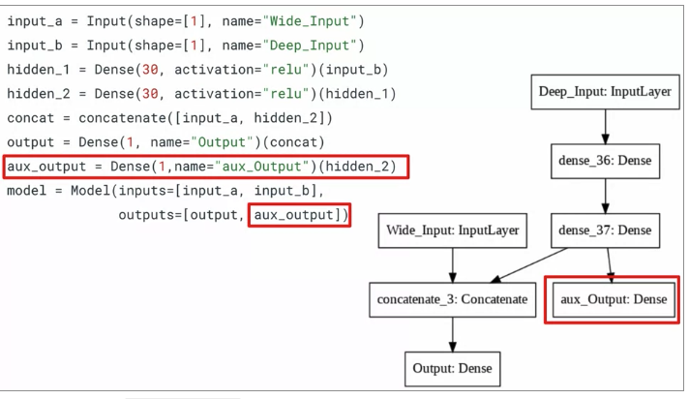
Custom model (1e)

Slide 31
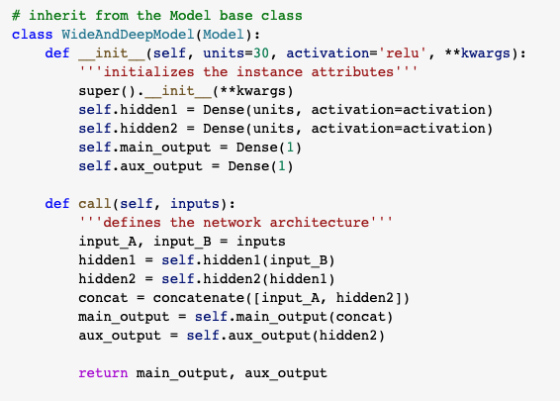
Implement as a class (1e)
inherit from Model
define init and call
define all layers in init
connect layers in call

Slide 32
Resnet

Slide 33
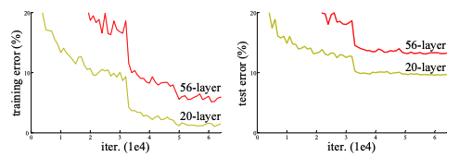
Deep models
having more layers enables vision systems to learn more levels of features in the input data
prior to ResNet, the ImageNet models had depths up to 16 to 30 layers
however, adding more layers can increase error
left: training error; right: test error on CIFAR-10

Slide 34
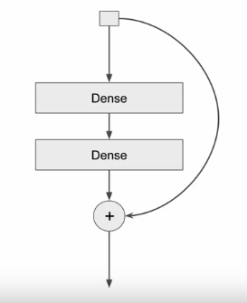
Resnet 2015 https://arxiv.org/abs/1512.03385
residual learning framework to help with training deep networks
since AlexNet, SOTA CNNs are deeper which is believed to help with overfitting
AlexNet: 5 layers
VGG: 19 layers
GoogleNet: 22 layers
deep networks suffer more from the vanishing gradient problem
residual layers are skip-connection blocks that learn residual functions
the shortcut performs identity mapping (with padding), because the weights in the Dense layers will tend toward 0 with weight decay

Slide 35
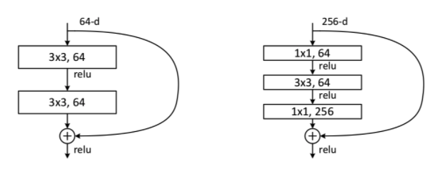
Residual blocks
the skip connections of the residual blocks allow for stacking deeper networks while avoiding degradation that happens in deep networks: When the network is near convergence, the accuracy becomes saturated and then degrades. This is not caused by overfitting.
outputs from earlier layers are passed down, summed element-wise the the outputs from the skipped layers

Slide 36
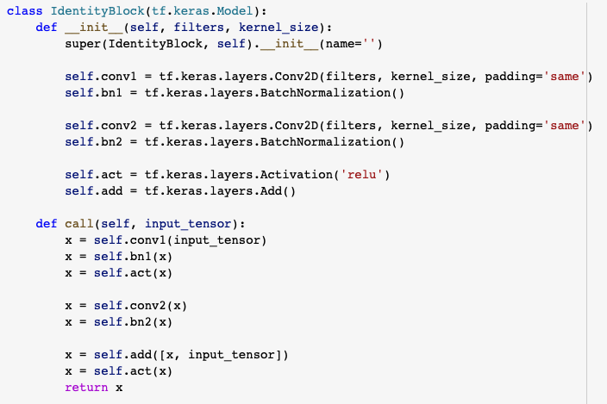
Resnet Identity Block
add( ) implements skip connections

Slide 37
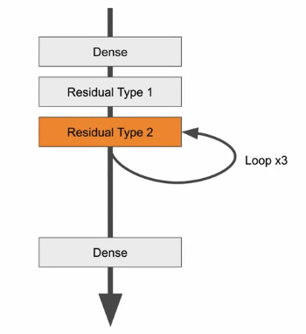
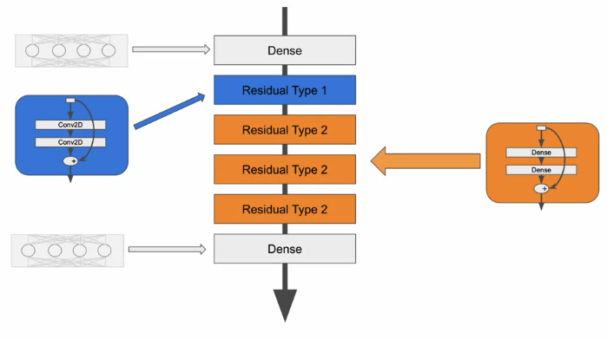
Resnet

Slide 38
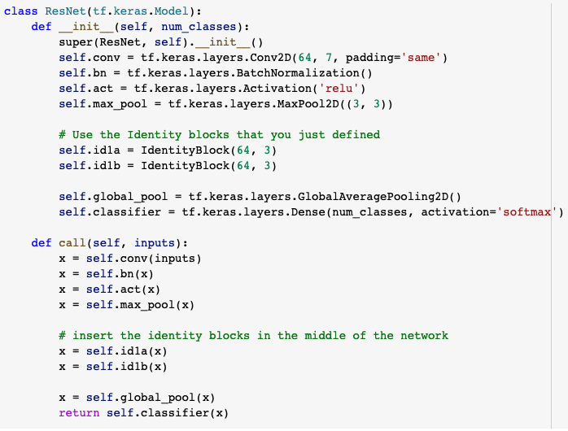
Resnet Model subclasses
call IdentityBlock 2 times

Slide 39
Callbacks

Slide 40
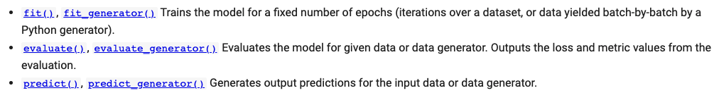
Callbacks (1g)
callbacks give an inside view various stages of training and evaluation
The following tf.keras.Model methods can accept callbacks:
See Notebook 1g for examples

Slide 41
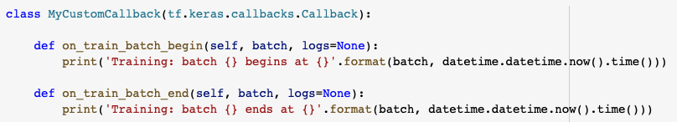
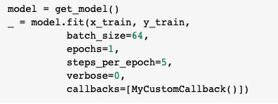
Custom callbacks
callback to track the start and end of every batch of data, prints batch index

Slide 42
TensorBoard
Visualization toolkit: https://www.tensorflow.org/tensorboard
See examples in Notebook 1g
https://www.tensorflow.org/tensorboard/get_started

Slide 43

Summary
Siamese Network
same weights on two inputs leading to one output
Loss Functions
- Huber
- Contrastive
Custom Layers
Custom Models
Callbacks
Next, on to the To Do list . . .

Slide 44

See you next time!
Karen.Mazidi@utdallas.edu

